Slide 1
Mutation testing
Web components

Slide 2


Unit testing
Code
Test
Notes:
What is WC (vs kendo)

Slide 3
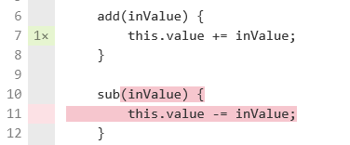
Code coverage
Test
Code coverage
Notes:
It is for you – show u what is not tested
It is for estimation

Slide 4
Code coverage
Test
Code coverage
Notes:
Disadvantages – example of uncovered

Slide 5

Code coverage
Test
Code coverage
Notes:
disadvantages

Slide 6
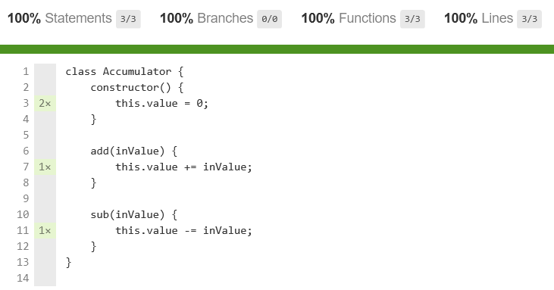
Code coverage
Notes:
disadvantages

Slide 7



Mutant
Code
Code coverage
Notes:
What is WC (vs kendo)

Slide 8
Mutant
Code
Bad test
Good test
Notes:
What is WC (vs kendo)

Slide 9
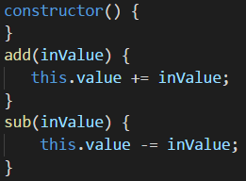
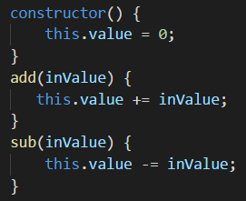
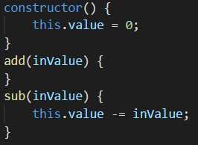
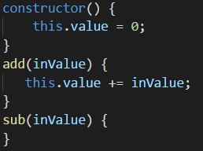
Mutants
Notes:
Let’s create mutant rule

Slide 10
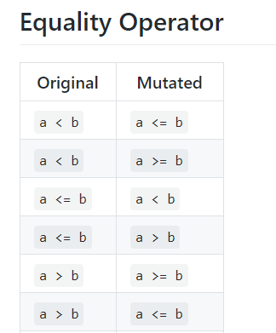
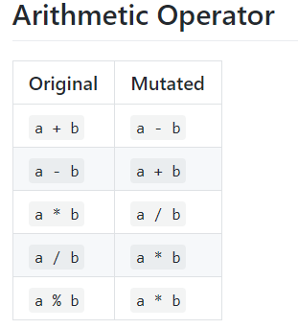
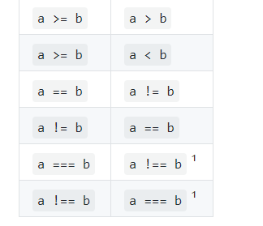
Mutations
Notes:
Let’s create all possible mutants – example

Slide 11

Mutations
Block Statement
Arithmetic Operator
Array Declaration
Boolean Literal
Checked Statement
Conditional Expression
Equality Operator
Logical Operator
String Literal
Unary Operator
Update Operator
https://github.com/stryker-mutator
Notes:
Let’s create all possible mutants – example

Slide 12
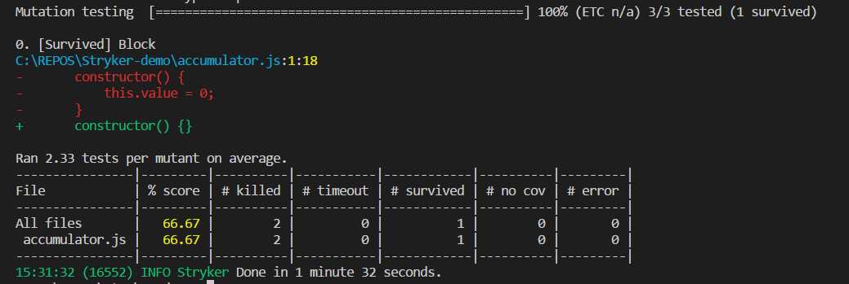
Mutant killing
Notes:
What is WC (vs kendo)

Slide 13
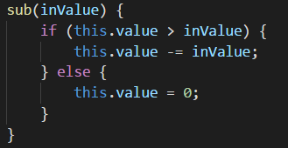

Equal mutant
Code
Stryker output
Notes:
What is WC (vs kendo)

Slide 14
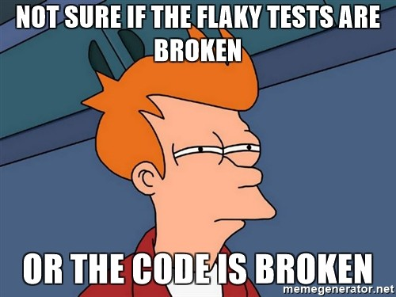
Flaky tests
Notes:
What is WC (vs kendo)

Slide 15

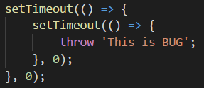
Jasmine/Karma fails
Notes:
What is WC (vs kendo)

Slide 16
Mutant testing complexity
N^2 ?
Independent for classes
Clear code restriction
Test coverage analyze
Notes:
What is WC (vs kendo)

Slide 17
Mutant testing advantages and disadvantages
Hard tested code
Show true untested code
Force to write code smarter
Hard to test code
Hard to change code
“Score” is not objective
Notes:
What is WC (vs kendo)

Slide 18


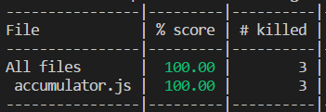
Mutant tests can generate code?
Code
Tests
Notes:
What is WC (vs kendo)

Slide 19
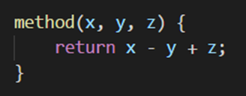
Mutant tests can generate code?
Code
Tests
Notes:
What is WC (vs kendo)

Slide 20

Mutation level
Level 0
Level 1
Level 2
Notes:
What is WC (vs kendo)

Slide 21
Whole level mutation testing
Level 1
Level 2
Level N
Code
mutation
quantity
N
> N*(N-1)/2
…
> 2^N
Test quantity
increase
x2
1..2?
…
0
Test lines
quantity
increase
x4
?
…
0
Notes:
What is WC (vs kendo)

Slide 22

Whole level mutation tests can generate code?
Notes:
What is WC (vs kendo)

Slide 23
Whole level mutation tests can generate code?
Notes:
What is WC (vs kendo)

